Slide 1
Data Analysis Portfolio
Chinmayee Manjunath
Data Analytics Trainee

Slide 2
INTRODUCTION
I am currently working as a data analyst at a startup. I have completed my B.E. in civil engineering securing about 7.5 CGPA. Even though I have done my degree in civil engineering I wanted a career change and was interested in the field of data analytics. I have several skills in data such as MS Excel, MySQL, Python, Power BI, and Statistics.
I have worked as a GIS Analyst for 2 years. After completing two years, as I was interested to switch my career I was more interested in the field of data. I started to improve my skills I power BI and MySql. Currently I am working as a data analyst at a startup where my primary works is based on Power BI and MySQL.

Slide 3
In order to update my skills in the field of data analytics I enrolled to the trainity Data Analytics course were I have gained knowledge on excel, python, and statistics. The course has also helped me to increase my knowledge on MySQL and PowerBI.
I am very flexible and ready to adjust in any environment. I am adaptive to work under pressure. I have Leadership Quality with strong influencing skills. I am Team player and Motivator having group dynamics.
I am looking forward to experience the challenges in the corporate world and to experience how things work in the field of data analytics. I hope I can apply my theoretical knowledge into the practical world.

Slide 4
TABLE OF CONTENT
Professional Background 1-3
Table of Contents 4
Data Analytics Process 5-9
Instagram User Analytics 10-21
Operation Analytics and Investigating Metric Spike 22-39
Hiring Process Analytics 40-52
IMDB Movies Analysis 53-65
Bank Loan Case Study 66-84
Impact of Car Features 85-103
ABC Call Volume Trend 104-116
Appendix 117

Slide 5
Data Analytics Process

Slide 6
Description
This project demonstrates how data analytics techniques can be applied to everyday scenarios like planning a birthday party and preparing a food recipe. Both examples follow a structured approach similar to data-driven decision-making, using defined steps to solve problems efficiently. The process involves planning, preparing, processing, analyzing, sharing, and acting on data to make well-informed decisions that lead to successful outcomes.

Slide 7

Case Study 1: Planning A Friends Birthday Party
Plan:
Define the Problem: Decide the type of party, set a budget, and create a guest list.
Set Objectives: Ensure a memorable event for the birthday person, maintain guest satisfaction, and stay within budget.
Prepare:
Gather Information: Collect data on guests' preferences (food, drinks, music) and research venues, activities, and costs.
Organize Data: Create a spreadsheet or list to manage guest information, preferences, budget estimates, and event options.
Process:
Clean the Data: Verify guest details, adjust the budget, and finalize party components (venue, menu, activities).
Transform the Data: Calculate costs, create guest invitations, and prepare a party timeline.
Analyze:
Explore Preferences: Identify common guest preferences and themes.
Evaluate Costs: Look for cost-saving measures without sacrificing quality.
Draw Conclusions: Determine the best party theme, venue, and activities.
Share:
Present the Plan: Share the finalized party plan with the birthday person and others involved.
Visualize: Create a timeline or budget breakdown for clarity.
Act:
Implement Decisions: Book the venue, send invitations, and purchase decorations and supplies.
Monitor Progress: Track expenses and make adjustments as needed.
Post-event Evaluation: Collect feedback to assess the event’s success and areas of improvement

Slide 8

Case Study 2: Preparing a Recipe
Plan:
Define the Problem: Decide on the dish and accommodate any dietary restrictions or preferences.
Set Objectives: Ensure the meal is delicious and meets the diners' expectations.
Prepare:
Gather Information: Review recipes, available ingredients, and necessary kitchen tools.
Organize Data: List ingredients and steps, determining quantities and cooking order.
Process:
Clean the Data: Ensure all ingredients are available in sufficient quantities.
Transform the Data: Plan cooking steps based on preparation time and ingredient needs.
Analyze:
Explore Alternatives: Identify substitutions for missing ingredients and possible flavor enhancements.
Optimize Cooking: Determine the best cooking method and timing for a high-quality result.
Share:
Present Recipe Plans: Discuss the dish with those eating to ensure it meets their preferences.
Act:
Execute the Recipe: Prepare the dish and adjust based on taste checks during cooking.
Finalize: Serve the meal and get feedback for future improvements

Slide 9
Conclusion:
Both case studies highlight how a structured data analytics approach can significantly improve decision-making and outcomes in everyday scenarios. By applying the same steps used in professional data analytics—planning, gathering data, processing, analyzing, sharing, and acting—complex tasks such as organizing events and cooking can become streamlined, efficient, and successful.
For the birthday party, data-driven insights on guest preferences and budget constraints ensure a well-rounded event, while in the food recipe case, methodical planning and analysis guarantee a delicious, well-prepared meal. Both examples emphasize the importance of data organization and feedback loops, showing how even routine activities can benefit from a formalized analytical approach.
Ultimately, this project demonstrates that data analytics isn't limited to business or tech—it can be applied practically to make everyday decisions better, more informed, and more enjoyable.

Slide 10
Instagram User Analytics

Slide 11
Description
This project focuses on analyzing Instagram user data to provide insights for marketing strategies and investor metrics. For marketing, key actions include identifying loyal and inactive users, researching popular hashtags, determining contest winners, and recommending optimal ad campaign timing. The investor analysis calculates average user engagement through posts per user and identifies potential bot or fake accounts that display abnormal behavior by liking every photo on the platform. SQL queries are used to extract valuable data from the user, photo, and like records.

Slide 12
Understanding the problem
Marketing Analysis
Investor Metrics
Loyal User Reward
Inactive User Engagement
Contest Winner Declaration
Hashtag Research
Ad Campaign Launch
User Engagement
Bots & Fake Accounts

Slide 13
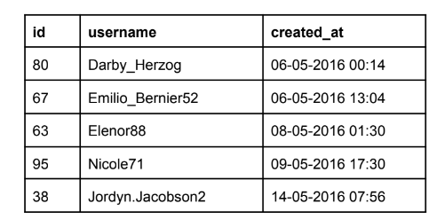
Marketing Analysis
1. Loyal User Reward: Identify the five oldest users on Instagram from the provided database.
Output:
To find the most loyal i.e. the top 5 oldest users of Instagram:
1. We will use the data from the users table by selecting the username
and created_at columns.
2. Then using the order by function we will order the desired output
by sorting with the created_at column in ascending order.
3. Then using the limit function, the output will be displayed for top 5
oldest Instagram users.
As we see in the above table the five oldest users are of id.no 80,67,63,95,38. So, we consider them as
Loyal Users. Most of them joined instagram in the month of may in 2016.

Slide 14
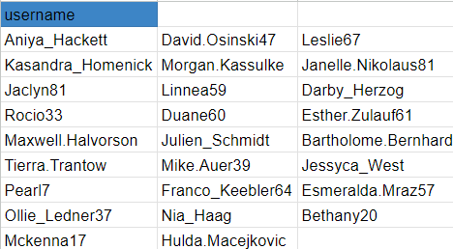
2. Inactive User Engagement: Identify users who have never posted a single photo on Instagram.
Output:
To Find the most inactive users i.e. the users who have never posted a
single photo on Instagram:
1. We will first select username column from the users table.
2. Then we will left join photos table on the users table, on users.id = photos.user_id because, both the users.id and photos.user_id have common contents in them.
3. Then we will find rows from the users table where the photos.id IS NULL
As we see in the above table we have about 27 users who have never posted a single photo on Instagram. Hence, they can be declared as inactive users.

Slide 15
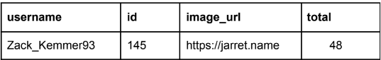
3. Contest Winner Declaration: Determine the winner of the contest and provide their details to
the team.
To find the most the username, photo_id, image_url and
total_number_of_likes of that image:
1. First we will select the users.username, photos.id, photos.image_url and count(*) of likes as total from photos
2. Then, we will inner join the three tables wiz : photos, likes and users, on likes.photo_id = photos.id and photos.user_id = users.id
3. Then, by using group by function we will group the output on the basis of photos.id
4. Then, using order by function we will sorting the data on the basis of
the total in descending order
5. Then, to find the most liked photo we will using limit function to view
only the top liked photo’s information Output
Code:
Select
username, photos.id, photos.image_url, count(likes.user_id) as total
from photos
inner join likes
on likes.photo_id=photos.id
inner join users
on photos.user_id = users.id
group by photos.id
order by total desc
limit 1;
Output:
So from the output we can conclude that Zack_Kemmer93 of id 145 has won the contest with 48 likes.

Slide 16
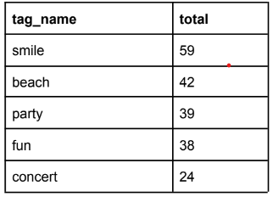
4. Hashtag Research: Identify and suggest the top five most commonly used hashtags on the platform.
Code:
Select
tags.tag_name,
count(*) as total
from photo_tags
join tags
on photo_tags.tag_id=tags.id
group by tags.id
order by total desc
limit 5;
To find the top 5 most commonly used hashtags on Instagram:
1. We need to select the tag_name column from the tag table and the
count(*) as total function so as to count the number of tags used
individually.
2. Then, we need to join tags table and photo_tags table, on tags.id =
photo_tags.tag_id cause they contain the same content in them i.e.
tag_id
3. Then using the group by function we need to group the desired output
on the basis of tags.tag_name
4. Then using the order by function we need to sort the output on the
basis of total(total number of tags per tag_name) in descending order
5. Then, to find the top 5 most used tag names we will use the limit 5
function.
Output:
In the table we have the top 5 most used hashtags for the partners brand to use in their posts to reach most people.

Slide 17
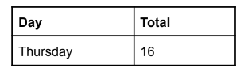
5.Ad Campaign Launch:Determine the day of the week when most users register on Instagram. Provide insights on when to schedule an ad campaign.
To find the day of week on which most users register on Instagram:
1. First we define the columns of the desired output table using select
dayname(created_at) as day_of_week and count(*) as
total_number_of_users_registered from the users table
2. Then using the group by function we group the output table on the
basis of day_of_week
3. Then using the order by function we order/sort the output table on the
basis of total_number_of_users_registered in descending order
Code:
select
dayname(created_at) as day, count(*) as total
from users
group by day
order by total desc
limit 1;
Output:
Even though there were two days Sunday and Thursday with the most users registered, sql has given output for Thursday as it comes first and Sunday comes last.

Slide 18
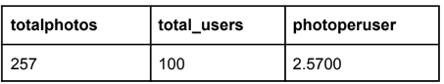
B) Investor Metrics:
1. User Engagement: Calculate the average number of posts per user on Instagram. Also, provide the total number of photos on Instagram divided by the total number of users.
Code:
select * from photos,users;
with base as(
select u.id as userid, count(p.id) as photoid from users u left join photos p on
p.user_id=u.id group by u.id)
select sum(photoid) as totalphotos,count(userid) as total_users,
sum(photoid)/count(userid)as photoperuser
from base;
Output:
Since the count from number of photos is 257 and the count from the number of users is
100 we have got the output for photoperuser as 2.5700

Slide 19
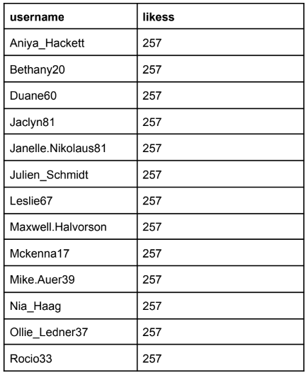
2. Bots & Fake Accounts: Identify users (potential bots) who have liked every single photo on the site, as this is not typically possible for a normal user.
Code:
select * from users,likes;
with base as(
select u.username,count(l.photo_id) as likess from likes l inner join users u on
u.id=l.user_id
group by u.username)
select username, likess from base where likess=(select count(*) from
photos)order by username;
Output:
As we can see in the table we have in total 13 bots and fake accounts

Slide 20
Analysis
The five oldest users are of id.no 80,67,63,95,38. So, we consider them as Loyal Users. Most of them joined instagram in the month of may in 2016.
We have about 27 users who have never posted a single photo on Instagram. Hence, they can be declared as inactive users.
Zack_Kemmer93 of id 145 has won the contest with 48 likes.
We have the top 5 most used hashtags for the partners brand to use in their posts to reach most people those are Smile, Beach, Party, Fun, Concert.
Even though there were two days Sunday and Thursday with the most users registered, sql has given output for Thursday as it comes first and Sunday comes last.
Since the count from number of photos is 257 and the count from the number of users is 100 we have got the output for photoperuser as 2.5700
We have in total 13 bots and fake accounts.

Slide 21
Conclusion
The project effectively utilizes SQL queries to provide actionable insights on user engagement, content popularity, and platform behavior. These findings help optimize marketing efforts and support business decisions, such as when to launch ad campaigns and how to handle potential bots. Overall, this data-driven approach helps Instagram improve user satisfaction, increase engagement, and maintain platform integrity.

Slide 22
Operation Analytics and Investigating Metric Spike

Slide 23
Description
This project revolves around two key case studies: job data analysis and investigating user engagement metric spikes. The first case analyzes jobs reviewed over time, throughput, language share, and identifies duplicate rows within a dataset. The second case investigates user engagement and growth patterns by calculating weekly engagement, growth rates, retention, and engagement metrics per device and email actions. SQL queries are employed to compute important business metrics, providing insights into job efficiency and engagement trends over time.

Slide 24
Understanding the problem
Job Data Analysis
Investigating Metric Spike
Weekly User Engagement
User Growth Analysis
Weekly Retention Analysis
Weekly Engagement Per Device
Email Engagement Analysis
Jobs Reviewed Over Time
Throughput Analysis
Language Share Analysis
Duplicate Rows Detection

Slide 25
Job Data Analysis
A. Jobs Reviewed Over Time: Write an SQL query to calculate the number of jobs reviewed per hour for each day in November 2020.
Data Retrieval: The first SELECT * FROM job_data retrieves all records from the job_data table, providing a general view of the data.
Nested Query Calculation: In the nested query, for each day (ds) in November (filtered by WHERE MONTH(ds) = 11), the query calculates two key metrics:
t: The number of jobs reviewed per hour by multiplying the count of job_id by 3600 and dividing it by the total time spent on those jobs.
p: The number of jobs reviewed per second, calculated by dividing the count of job_id by the total time spent.
Data Aggregation: The inner query groups the results by ds (each day), which allows calculating the number of jobs reviewed per hour and per second for each day in November.
Averaging Results: The outer query takes the average (AVG) of the daily job review rates (t for per-hour and p for per-second) across the entire month.
Final Output: The result provides the average number of jobs reviewed per day per hour (avg_jobs_reviewed_per_day_per_hour) and per second (avg_jobs_reviewed_per_day_per_second) for November.

Slide 26
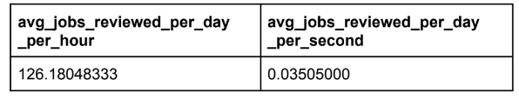
Code:
SELECT * FROM job_data;
SELECT
AVG(t) AS 'avg_jobs_reviewed_per_day_per_hour',
AVG(p) AS 'avg_jobs_reviewed_per_day_per_second'
FROM
(
SELECT
ds,
((COUNT(job_id) * 3600) / SUM(time_spent)) AS t,
(COUNT(job_id) / SUM(time_spent)) AS p
FROM
job_data
WHERE
MONTH(ds) = 11
GROUP BY ds
) a;
Output:
Insight:
In the query, we are figured out how fast jobs were being reviewed in November by
calculating the average number of jobs finished in an hour and a second for each day of the
month. So the output for avg_jobs_reviewed_per_day_per_hour is 126.18048333 and
avg_jobs_reviewed_per_day_per_second is 0.03505000

Slide 27
B. Throughput Analysis: Write an SQL query to calculate the 7-day rolling average of throughput. Also, explain why you prefer using the daily metric or the 7-day rolling average for throughput.
This query calculates throughput, which measures the efficiency of job completion over time, both weekly and daily. Here's an explanation:
First Query (Weekly Throughput):
SELECT ROUND(COUNT(event)/SUM(time_spent), 2): This calculates the weekly throughput by dividing the total number of jobs (COUNT(event)) by the total time spent (SUM(time_spent)), rounding the result to two decimal places.
The result represents how many jobs are completed per unit of time (e.g., per hour or per second) across the entire dataset.
Output: A single value for "Weekly Throughput," representing the overall efficiency for the whole dataset.
Second Query (Daily Throughput):
SELECT ds AS Dates: The ds column represents the date. This query will show the throughput for each individual day.
ROUND(COUNT(event)/SUM(time_spent), 2): For each date (ds), it calculates the daily throughput by dividing the total number of jobs (COUNT(event)) by the total time spent (SUM(time_spent)) on that day, rounding the result to two decimal places.
GROUP BY ds: The query groups the data by each day (ds) to calculate the throughput for each day separately.
ORDER BY ds: The query sorts the results by date to show the daily throughput in chronological order.
Final Output:
The first query provides a weekly throughput metric across the entire dataset.
The second query breaks down throughput for each day, giving a daily view of how efficiently jobs were completed on a per-day basis.

Slide 28
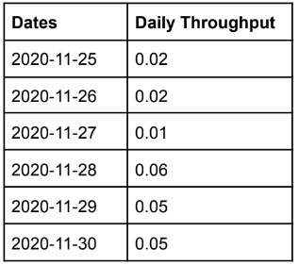
Code:
SELECT ROUND(COUNT(event)/SUM(time_spent), 2) AS "Weekly Throughput"
FROM job_data;
SELECT ds AS Dates, ROUND(COUNT(event)/SUM(time_spent), 2) AS "Daily
Throughput" FROM job_data
GROUP BY ds ORDER BY ds;
Output:
Insight:
In the above query, calculate throughput, which measures how many jobs are completed per unit of time. In the first query, we calculate the weekly throughput by calculating the total number of jobs completed divided by the total time spent on all jobs for an entire week, giving us an output of 0.03. In the next query, we calculate the daily throughput by dividing the number of jobs completed by the total time spent for each day which in turn provides us a daily breakdown of efficiency which is shown in the above output.

Slide 29
C. Language Share Analysis: Write an SQL query to calculate the percentage share of each language over the last 30 days.
This SQL query calculates the percentage of jobs completed in each language relative to the total number of jobs.
CROSS JOIN: First, it calculates the total number of jobs in the job_data table (COUNT(*) AS total) and makes this value available for every row using a CROSS JOIN.
COUNT(*): For each language, it counts how many jobs were completed.
ROUND(100 * COUNT(*) / total, 2): It calculates the percentage share of jobs completed in each language by dividing the language-specific count by the total count, multiplying by 100, and rounding to two decimal places.
GROUP BY language: The query groups the data by language to compute percentages for each one.
Output: The result shows the language, the percentage of total jobs completed in that language, and the total number of jobs.

Slide 30
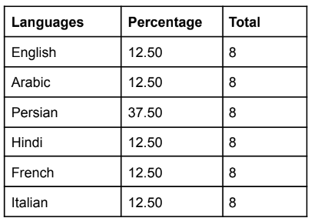
Code:
SELECT language AS Languages,
ROUND(100 * COUNT(*)/total, 2) AS
Percentage, sub. total
FROM job_data
CROSS JOIN
(SELECT COUNT(*) AS total FROM job_data) AS sub
GROUP BY language, sub. total;
Output:
Insight:
In task C we have this query which calculates the percentage of jobs completed in each language relative to the total number of jobs. We can achieve this by counting jobs by language by grouping the data and counting the number of jobs in each group. The result is the percentage of jobs completed in each language alongside the total number of jobs.

Slide 31
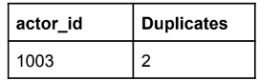
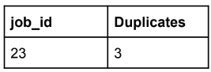
D. Duplicate Rows Detection:
Write an SQL query to display duplicate rows from the job_data table.
Code:
SELECT actor_id, COUNT(*) AS Duplicates FROM job_data
GROUP BY actor_id HAVING COUNT(*) > 1;
Output:
Code:
SELECT job_id, COUNT(*) AS Duplicates FROM job_data
GROUP BY job_id HAVING COUNT(*) > 1;
Insight:
The above query identifies duplicate records within the job_data table based on the actor_id.
Although duplicate values are present in the job_id column also we have a query to identify
duplicate values in the job_id column.

Slide 32
Investigating Metric Spike
A. Weekly User Engagement: Write an SQL query to calculate the weekly user engagement.
This SQL query calculates weekly user engagement by identifying the number of unique users interacting with a product based on the event type.
select * from events: The first query displays all data from the events table.
extract(week from occurred_at): This function extracts the week number from the occurred_at timestamp, indicating when the event happened.
count(distinct user_id): It counts the number of distinct users (user_id) who have engaged with the product.
where event_type='engagement': Filters events to include only those classified as 'engagement'.
group by week_number: The results are grouped by week to show engagement for each week. The output provides a count of unique active users per week.

Slide 33
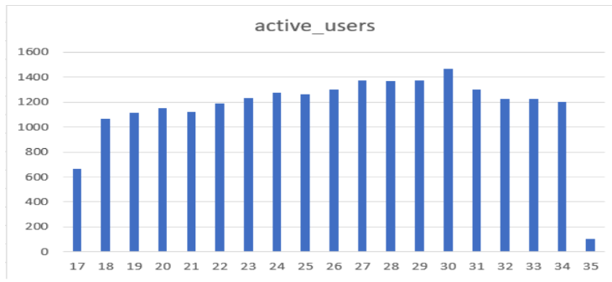
Code:
# Viewing the table
select * from events
#Running the Query
select extract(week from occurred_at) as week_number,
count(distinct user_id) as active_user
from events
where event_type='engagement'
group by week_number
Insights:
The provided SQL query calculates the number of unique users engaging with a product weekly.
The week where the active users were highest is the 30th week with 1467 active users

Slide 34
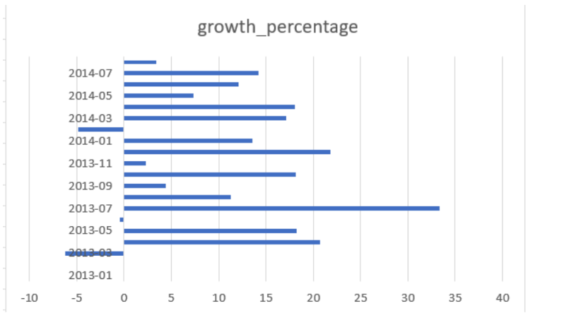
B. User Growth Analysis: Write an SQL query to calculate the user growth for the product.
We have tried to analyze the user growth in the above SQL query. From the output, we can see
that the highest user growth percentage was in July 2013 at 33.33 percent, with a user growth
71. But if we observe the user growth column the highest user growth is in July 2014 with 124
user growth. Since we are comparing the present month's user growth with the previous month the highest percentage remains for July 2013 since in the previous month there was a loss of one user.

Slide 35
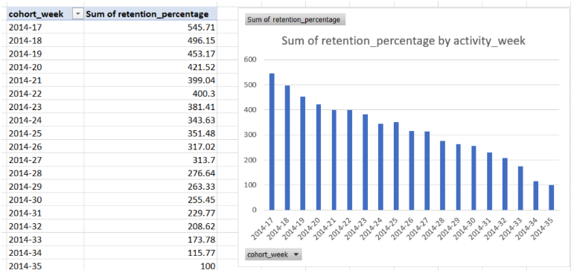
C. Weekly Retention Analysis: Write an SQL query to calculate the weekly retention of users based on their sign-up cohort.
We have tried to calculate the weekly retention of users based on their sign-up cohort. As per the output 2014-17 had the highest retention rate with 545.71% as it was the starting cohort week further we can see the dip of retention percentage up to 100 at week 2014-35.

Slide 36
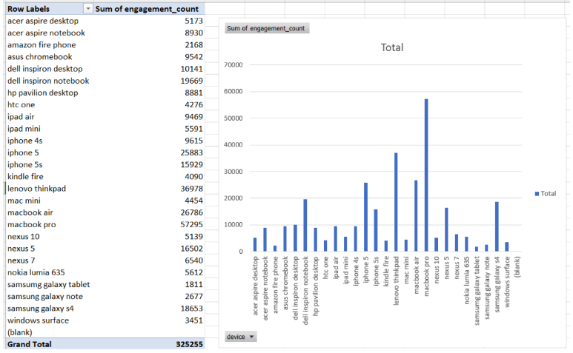
D. Weekly Engagement Per Device: Write an SQL query to calculate the weekly engagement per device.
We have extracted the year and week from the date format. used the device to group the devices, the count of the number of events per week per device is represented as the engagement. We have performed group by on both device and week and order by on week and engagement_count in descending order. By analyzing the data we know that the MacBook Pro has the highest engagement count and the Amazon Fire phone with lowest engagement count.

Slide 37
E. Weekly Engagement Per Device: Write an SQL query to calculate the email engagement metrics.
Code:
SELECT
DATE_FORMAT(occurred_at, '%Y-%u') AS week,
action,
COUNT(*) AS action_count
FROM
emailEvents
GROUP BY
week, action
ORDER BY
week, action_count DESC;
Insights:
In this task, we calculated email engagement metrics, so in the above query we have tried to create a new column called action_count This counts the number of occurrences for each action type per week. We have grouped the output by week and action and performed order by week and action_count in descending order. where sent_weekly_digest is the highest action done with 57267 actions and sent_reengagement_email is the lowest with 3653 actions.

Slide 38
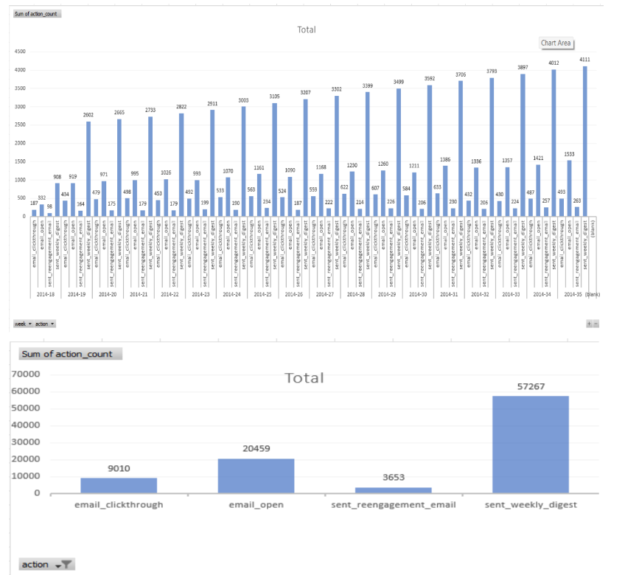
Output:

Slide 39
Conclusion:
This project successfully highlights how SQL can be used to gain operational insights, such as job throughput and language distribution, while investigating engagement spikes. By understanding user engagement, retention, and device usage, companies can optimize their operations and enhance product performance. The analysis of weekly and monthly metrics, as well as cohort-based retention, helps identify critical patterns that support business decision-making and strategy formulation.

Slide 40
Hiring Process Analytics

Slide 41
The Hiring Process Analytics project involves analyzing various aspects of a company's recruitment process, including gender distribution, salary trends, departmental composition, and position tiers. The hiring analysis examines the gender breakdown of hires, while the salary analysis calculates the average salary offered, both overall and by department. The salary distribution analysis classifies salary data into intervals to show distribution patterns. The departmental analysis uses visualizations to present the proportion of employees across departments, and the position tier analysis reveals the distribution of employees across different job levels.
Description

Slide 42
Understanding the problem
A. Hiring Analysis:
Determine the gender distribution of hires. How many males and females have been hired by the company?
B. Salary Analysis:
What is the average salary offered by this company? Use Excel functions to calculate this.
C. Salary Distribution:
Create class intervals for the salaries in the company. This will help you understand the salary distribution.
Deliverable 3
D. Departmental Analysis:
Use a pie chart, bar graph, or any other suitable visualization to show the proportion of people working in different departments.
Deliverable 4
Use a chart or graph to represent the different position tiers within the company. This will help you understand the distribution of positions across different tiers.
E. Position Tier Analysis:

Slide 43
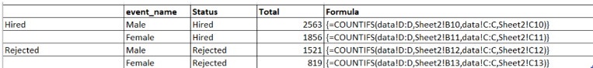
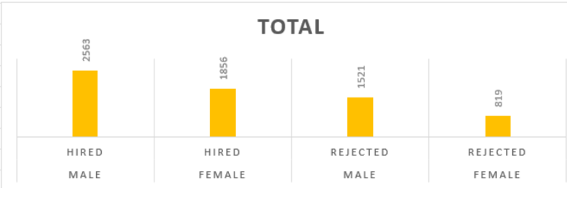
In order to find the total males and females hired by the company I have used the COUNTIFS function where i have filtered out hired and rejected further i have sorted male and female so that i can get the desired output as we can see in the output the total males hired is 2563 and with females it is 1856.
A. Hiring Analysis: Determine the gender distribution of hires. How many males and females have been hired by the company?
Table:
Chart:

Slide 44
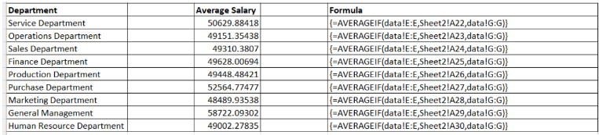
To find the Average salary in each department we have used the function AVERAGEIF where the formula considers only the desired department to calculate the average salary.
B. Salary Analysis: What is the average salary offered by this company? Use Excel functions to calculate this.
Table:

Slide 45
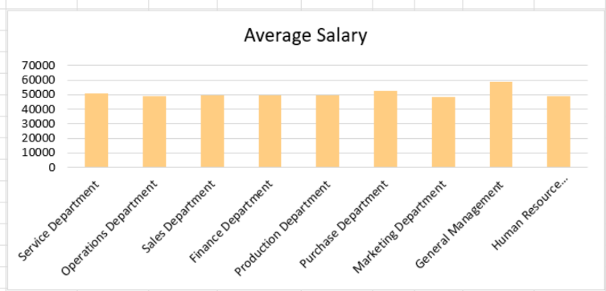
In the above output, we can find the average salary in individual departments. But if we need the
average salary for the whole company the average would be Average/Mean = 49983.02902
(Formula=AVERAGE(Data!G:G)).
Chart:

Slide 46
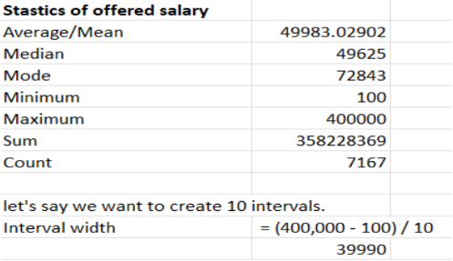
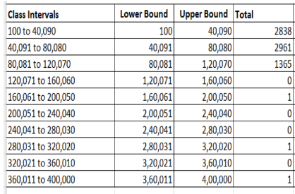
From the statistics on the salary we have 100 in min values and 400000 in max value. So, lets just consider we need 10 intervals, the interval width comes down to 39990 per interval. The calculated total salary per class interval is calculated using the formula {=COUNTIFS(data!G1:G7168, ">="&B50, data!G1:G7168, "<="&C50)}
C. Salary Distribution: Create class intervals for the salaries in the company. This will help you understand the salary distribution.
Class Intervals:
Table:

Slide 47
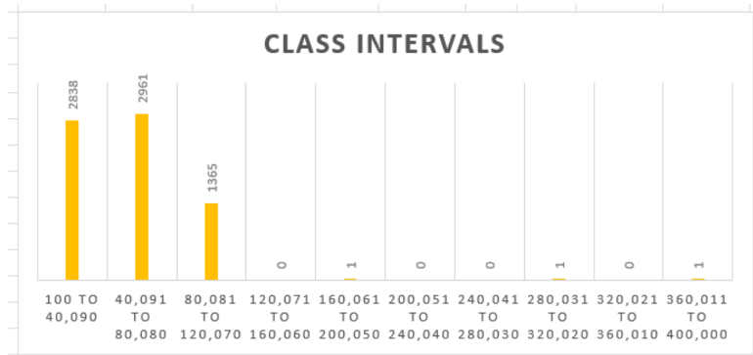
So from the above chart we can see that the class intervals between 40091 to 80080 has the highest salaried employes which is about 2961.
Chart:

Slide 48
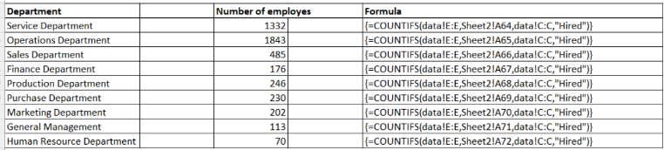
To find the number of employe in each department we have used the COUNTIF function which helps us to filter out the department which we need to calculate the number of employe in.
D. Departmental Analysis: Use a pie chart, bar graph, or any other suitable visualization to show the proportion of people working in different departments.
Table:

Slide 49
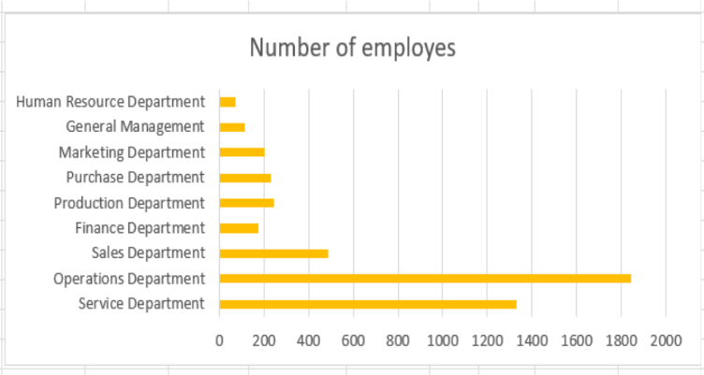
If we create a bar chart we get to see that the number of employe in operations department is higher with 1843 employes and the lowest department is human resource with 70 employes.
Chart:

Slide 50
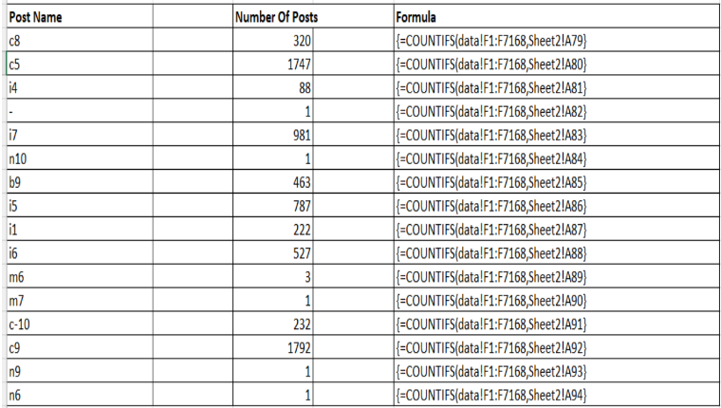
Since we have to calculate the number of posts based on the post name I have tried to extract the post name by using the function UNIQUE, and calculated the the total number of posts in each category by using COUNTIFS formula.
E. Position Tier Analysis:Use a chart or graph to represent the different position tiers within the company. This will help you understand the distribution of positions across different tiers.
Table:

Slide 51
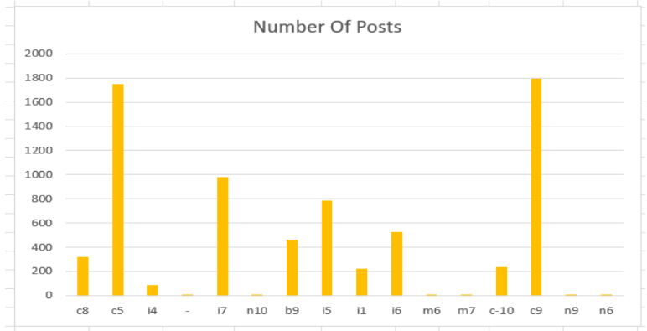
The highest number of post is present in post c9 with 1792 posts.
Chart:

Slide 52
This analysis provides valuable insights into the company’s hiring practices, salary structure, and workforce composition. By identifying gender disparities, salary trends, and departmental distribution, it offers a comprehensive view of the company's workforce and highlights areas for potential improvement in HR policies and salary equity.
Conclusion:

Slide 53
IMDB Movie Analysis
Final Project-1

Slide 54
Description
The IMDb Movie Analysis project focuses on identifying key factors that influence the success of movies, defined by high IMDb ratings. The analysis involves examining movie genres, durations, languages, directors, and budgets to uncover patterns that may contribute to success. By cleaning and preparing the data, the project moves into data analysis, including descriptive statistics and visualizations.

Slide 55
Approach: To complete this project I have undergone the following steps
DATA PREPARATION: We start by downloading and analyzing the data. Through this, we learn that we do not need all the columns in the data set. So further, we only retain the useful columns such as
director_name, duration, gross, genres, movie_title, language, country, budget, title_year, imdb_score
And by deleting the rows which have null values.
DATA ANALYSIS: After cleaning the data we performed different types of analyses to perform the given tasks such as descriptive analysis, data extraction, and visualizing the relationship between 2 or more variables.

Slide 56
Factors Targeted
Movie Genre Analysis
Movie Duration Analysis
Language Analysis
Director Analysis
Budget Analysis

Slide 57
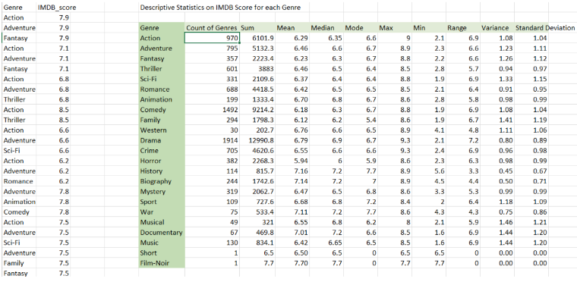
A. Movie Genre Analysis: Analyze the distribution of movie genres and their impact on the IMDB score.

Slide 58
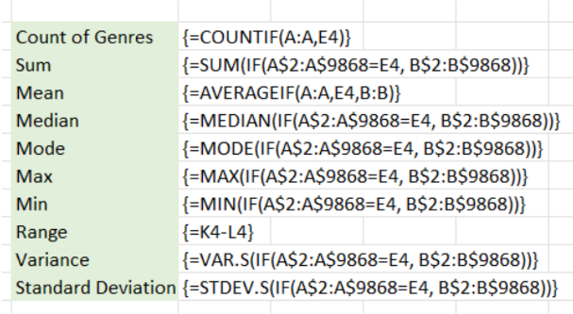
Result:
To arrive at the above result, I started with extracting the genre by using the split-by-delimiter function, and then I used the index function to unpivot the separated genre by using the formula,
[INDEX($B$2:$D$5,INT((ROW(A1)-1)/3)+1,MOD(ROW(A1)-1,3)+1)] and
[=INDEX($E$2:$E$5,INT((ROW(A1)-1)/3)+1)]
● After applying the above formula to get the modified data we move on to conduct the descriptive analysis where we calculate the count, sum of the IMDB Score, mean
median, mode, max, min, range, variance, and standard deviation.

Slide 59
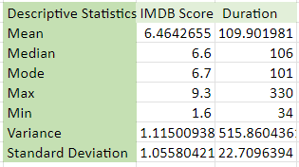
B. Movie Duration Analysis: Analyze the distribution of movie durations and its impact on the IMDB score.
● Task: Analyze the distribution of movie durations and identify the relationship between movie duration and IMDB score.

Slide 60
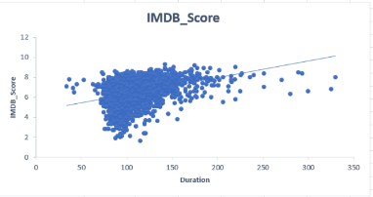
Result: In the above output we have performed the descriptive analysis on the duration
and IMDB score of the movies and a scatter plot between them.

Slide 61
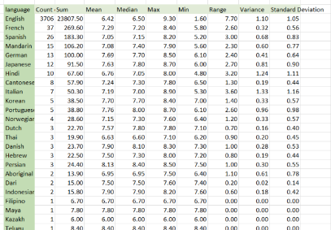
C. Language Analysis: Situation: Examine the distribution of movies based on their language.
● Task: Determine the most common languages used in movies and analyze their impact on the IMDB score using descriptive statistics.
To determine the most common language in movies i have conducted descriptive analysis by considering movie name, IMDB Score, and Language. I have calculated descriptive analysis on the languages.
Result: the language with the highest IMDB Score is English followed by French,
Spanish, Mandarin, and German.

Slide 62
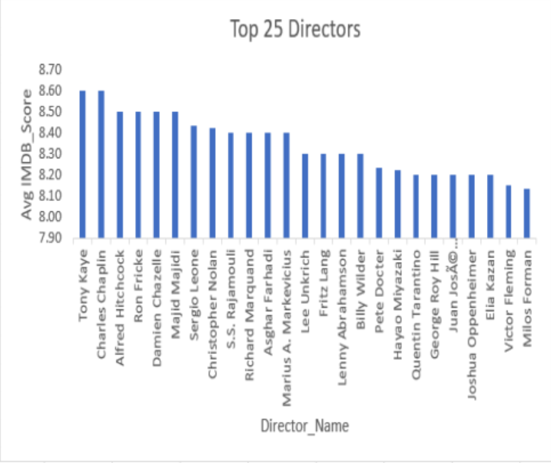
D. Director Analysis: Influence of directors on movie ratings.
● Task: Identify the top directors based on their average IMDB score and analyze their
contribution to the success of movies using percentile calculations.
To determine the top directors in movies i have calculated the average IMDB Score by considering movie name, IMDB Score, and Director name. The graph only represents the top 25 directors.
Result: The director with the highest IMDB Score is Tony Kaye with an 8.60 IMDB Score.

Slide 63
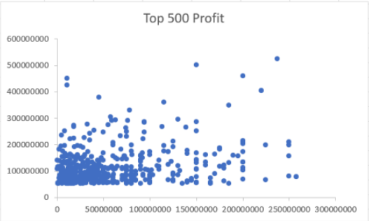
E. Budget Analysis: Explore the relationship between movie budgets and their financial success.
● Task: Analyze the correlation between movie budgets and gross earnings, and identify
the movies with the highest profit margin.
To determine the relationship between movie budgets and their financial success I have calculated the correlation between gross and budget and created a bubble chart in between budget and profit.
Result: Result: On calculating the correlation between gross and budget, we get a correlation of 0.102129, indicating a weak but positive correlation.

Slide 64
Insights:
Genre Analysis: A detailed breakdown of movie genres revealed their impact on IMDb scores, where descriptive statistics like mean, median, and variance were calculated for each genre.
Duration Analysis: A scatter plot showed the relationship between movie duration and IMDb score, identifying any correlations.
Language Analysis: The analysis highlighted English as the dominant language with the highest IMDb scores, followed by other common languages like French and Spanish.
Director Analysis: By ranking directors based on IMDb scores, Tony Kaye was identified as the top director.
Budget Analysis: A weak positive correlation was found between budget and gross earnings, indicating that higher budgets do not guarantee financial success.

Slide 65
Conclusion
The findings provide valuable insights into how various factors, like genre, language, and director, influence movie ratings. Despite a weak correlation between budget and box office success, the analysis offers filmmakers and investors data-driven insights to optimize future projects.

Slide 66
Bank Loan Case Study
Final Project-2

Slide 67
Description
This project involves analyzing a loan application dataset for a finance company to identify factors that influence loan defaults. The company's challenge is twofold: denying loans to applicants who may be capable of repayment results in lost business, while approving loans to those who default leads to financial losses. The dataset includes various customer and loan attributes, with two primary scenarios: customers with payment difficulties and customers with timely payments. The goal is to use Exploratory Data Analysis (EDA) to detect patterns that could help the company make more informed decisions about loan approval, amount adjustments, or increased interest rates for higher-risk customers.

Slide 68
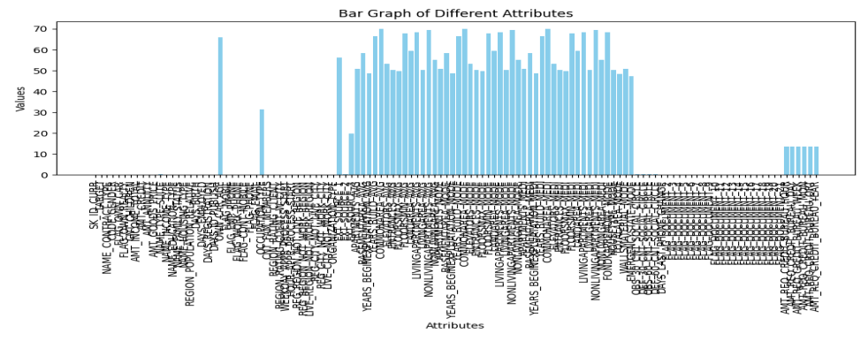
A. Identify Missing Data and Deal with it Appropriately: Identify the missing data in the dataset and decide on an appropriate method to deal with it using Excel built-in functions and features.

Slide 69
Above is the bar graph that represents the percentage of missing values in each columns.when it comes to the way the data has been handled, the attributes with more than or equal to 40% of missing values has been dropped. In the next step of cleaning some of the attributes which are not necessary for the analyzation has been removed. The columns that have been removed are
'FLAG_MOBIL', 'FLAG_EMP_PHONE', 'FLAG_WORK_PHONE', 'FLAG_CONT_MOBILE', 'FLAG_PHONE','FLAG_EMAIL','FLAG_DOCUMENT_2','FLAG_DOCUMENT_3','FLAG_DOCUMENT_4', 'FLAG_DOCUMENT_5','FLAG_DOCUMENT_6','FLAG_DOCUMENT_7', 'FLAG_DOCUMENT_8', 'FLAG_DOCUMENT_9','FLAG_DOCUMENT_10', 'FLAG_DOCUMENT_11', 'FLAG_DOCUMENT_12', 'FLAG_DOCUMENT_13', 'FLAG_DOCUMENT_14', 'FLAG_DOCUMENT_15', 'FLAG_DOCUMENT_16', 'FLAG_DOCUMENT_17', 'FLAG_DOCUMENT_18', 'FLAG_DOCUMENT_19', 'FLAG_DOCUMENT_20', 'FLAG_DOCUMENT_21', 'EXT_SOURCE_2', 'EXT_SOURCE_3'.
In the next step the columns which have negative values has been converted into positive
values by using absolute function. Those columns are
'DAYS_BIRTH', 'DAYS_EMPLOYED', 'DAYS_REGISTRATION', 'DAYS_ID_PUBLISH',
'DAYS_LAST_PHONE_CHANGE'.
There were few columns with less missing values which could be replaced so those values have been replace by there mean median or mode depending on the data type those columns. Similar process was applied on the previous application data set also.

Slide 70
B. Identify Outliers in the Dataset: Outliers can significantly impact the analysis and distort the results. You need to identify outliers in the loan application dataset.
Task: Detect and identify outliers in the dataset using Excel statistical functions and features, focusing on numerical variables.
In the given dataset few columns have appropriate values columns where outlier detection would be useful those columns are
AMT_INCOME_TOTAL
CNT_CHILDREN
AMT_CREDIT
AMT_ANNUITY

Slide 71
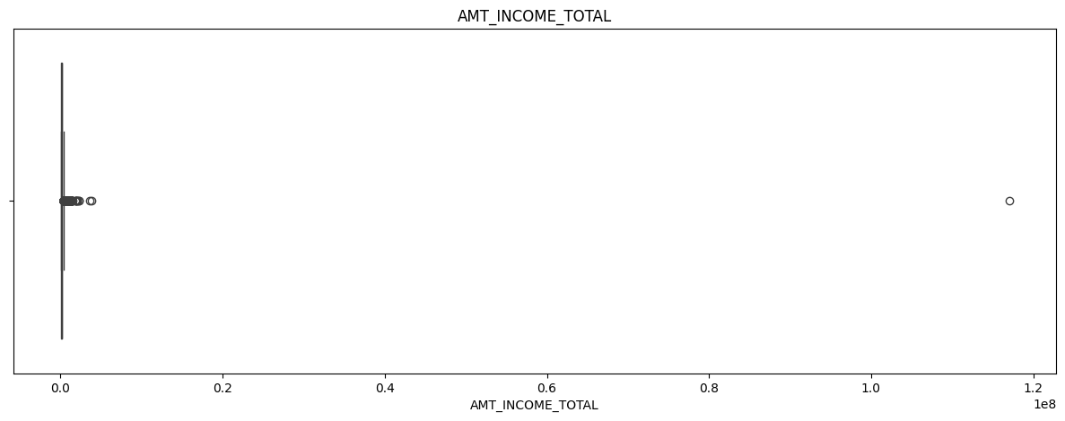
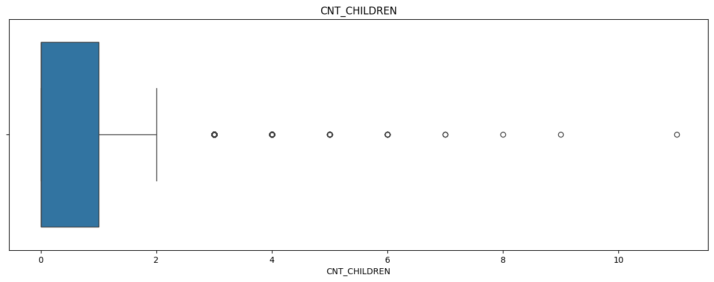
AMT_INCOME_TOTAL
#outlier for AMT_INCOME_TOTAL
plt.figure(figsize = (15,5))
sns.boxplot(x = merged_final_data['AMT_INCOME_TOTAL'])
plt.title('AMT_INCOME_TOTAL')
plt.show()
CNT_CHILDREN
# outlier for CNT_CHILDREN
plt.figure(figsize = (15,5))
sns.boxplot(x = merged_final_data['CNT_CHILDREN'])
plt.title('CNT_CHILDREN')
plt.show()

Slide 72
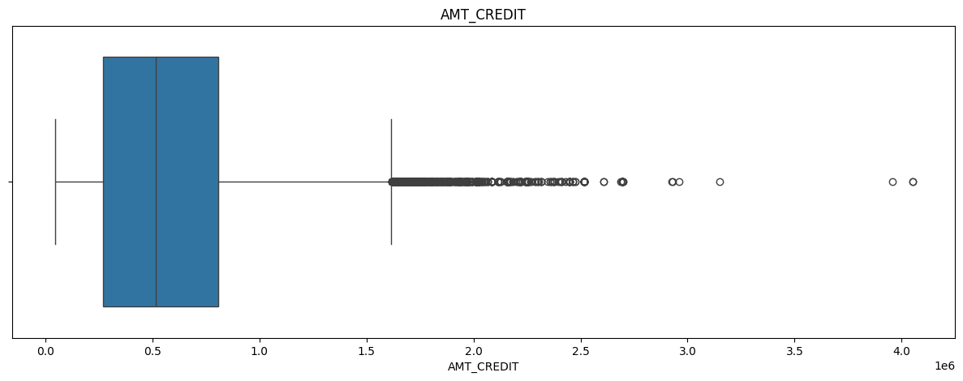
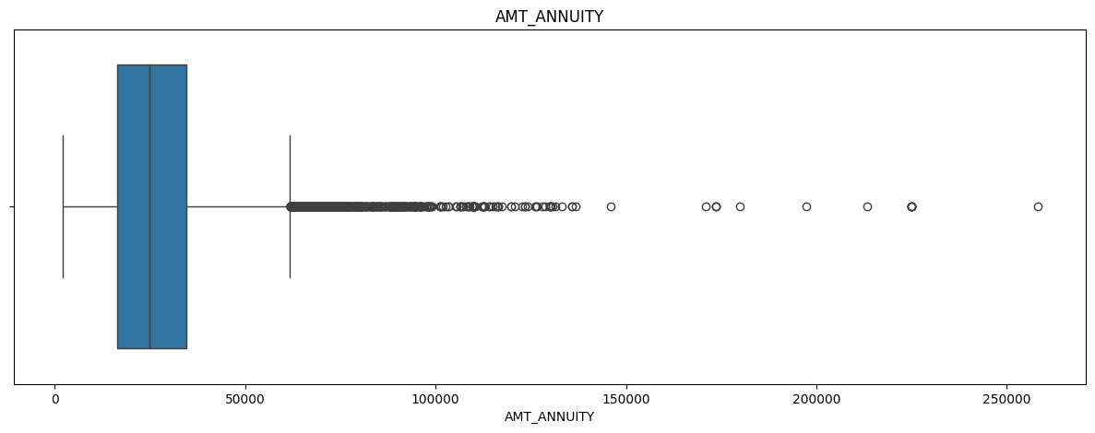
AMT_CREDIT
# outlier for AMT_CREDIT
plt.figure(figsize = (15,5))
sns.boxplot(x = merged_final_data['AMT_CREDIT'])
plt.title('AMT_CREDIT')
plt.show()
AMT_ANNUITY
# outlier for AMT_ANNUITY
plt.figure(figsize = (15,5))
sns.boxplot(x = merged_final_data['AMT_ANNUITY'])
plt.title('AMT_ANNUITY')
plt.show()

Slide 73
C. Analyze Data Imbalance: Data imbalance can affect the accuracy of the analysis, especially for binary classification problems. Understanding the data distribution is crucial for building reliable models.
Task: Determine if there is data imbalance in the loan application dataset and calculate the ratio of data imbalance using Excel functions.
The process first counts the occurrences of loan repayment statuses (repayers vs. defaulters) using the value_counts() function. A pie chart is then generated to visually represent the proportions of these two groups. Next, the script calculates the imbalance ratio by dividing the number of repayers by the number of defaulters. The final output displays the ratio, showing that for every 11 repayers, there is 1 defaulter, indicating significant data imbalance.

Slide 74
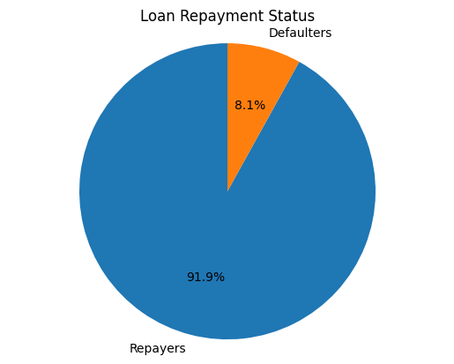
Code:
Chart:
Imbalance = merged_final_data["TARGET"].value_counts().reset_index()
labels = ['Repayers', 'Defaulters']
sizes = Imbalance['count']
fig, ax = plt.subplots()
ax.pie(sizes, labels=labels, autopct='%1.1f%%', startangle=90)
ax.axis('equal') # Equal aspect ratio ensures that pie is drawn as a circle.
plt.title('Loan Repayment Status')
plt.show()

Slide 75
D. Perform Univariate, Segmented Univariate, and Bivariate Analysis: To gain insights into the driving factors of loan default, it is important to conduct various analyses on consumer and loan attributes.
Task: Perform univariate analysis to understand the distribution of individual variables, segmented univariate analysis to compare variable distributions for different scenarios, and bivariate analysis to explore relationships between variables and the target variable using Excel functions and features.
Univariate Analysis: It examines the distribution of a single variable without considering relationships with other variables. Analysis performed on variables like AMT_CREDIT, AMT_ANNUITY, AMT_GOODS_PRICE, OCCUPATION_TYPE.
Segmented Univariate Analysis: It is a specific type of univariate analysis where the distribution of a single variable is examined across different groups or segments of the data. Analysis Performed on the distribution of a variable across segments, such as how AMT_CREDIT is distributed across different NAME_CONTRACT_TYPE values.
Bivariate Analysis: It examines the relationship between two variables to determine if they are associated in any way. we can explore the relationship between two variables, such as AMT_INCOME_TOTAL and AMT_CREDIT, to see if there is any correlation or pattern.

Slide 76
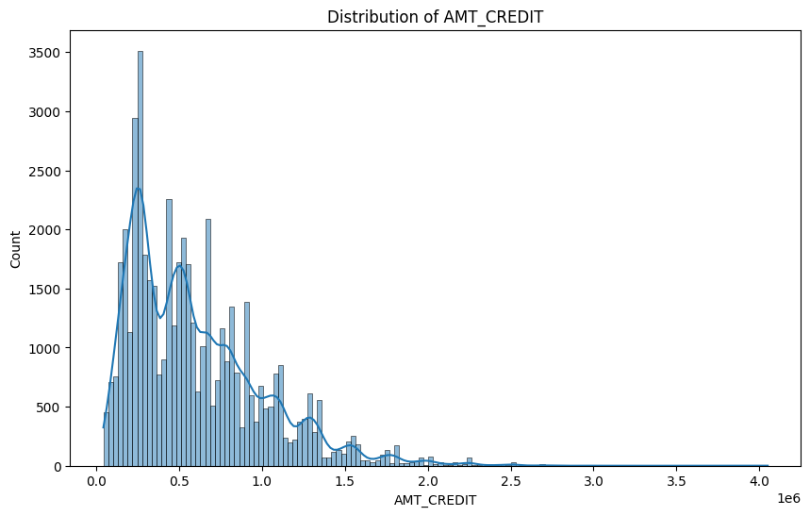
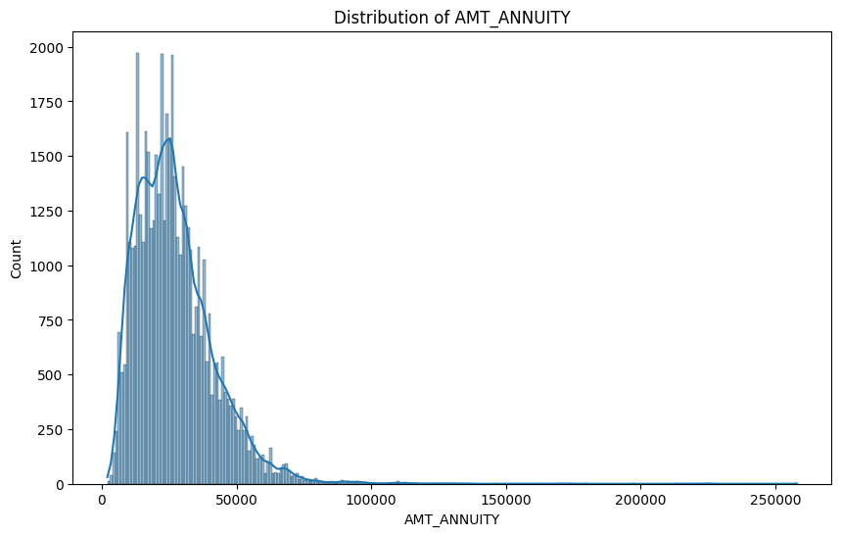
Univariate analysis
# Univariate analysis: Analyzing 'AMT_CREDIT'
plt.figure(figsize=(10,6))
sns.histplot(df['AMT_CREDIT'], kde=True)
plt.title('Distribution of AMT_CREDIT')
plt.show()
# Univariate analysis: Analyzing 'AMT_ANNUITY'
plt.figure(figsize=(10,6))
sns.histplot(df['AMT_ANNUITY'], kde=True)
plt.title('Distribution of AMT_ANNUITY')
plt.show()

Slide 77
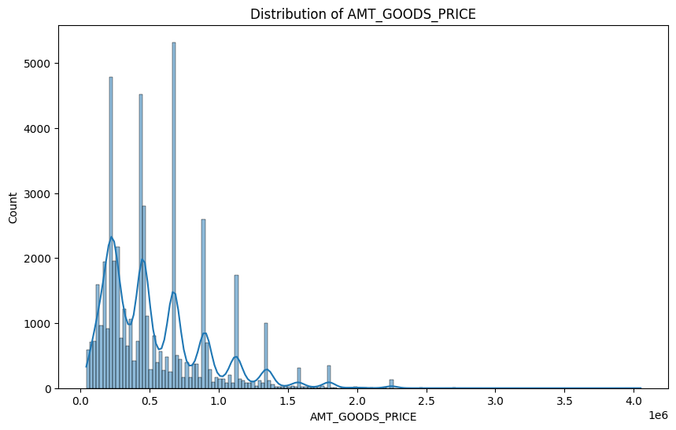
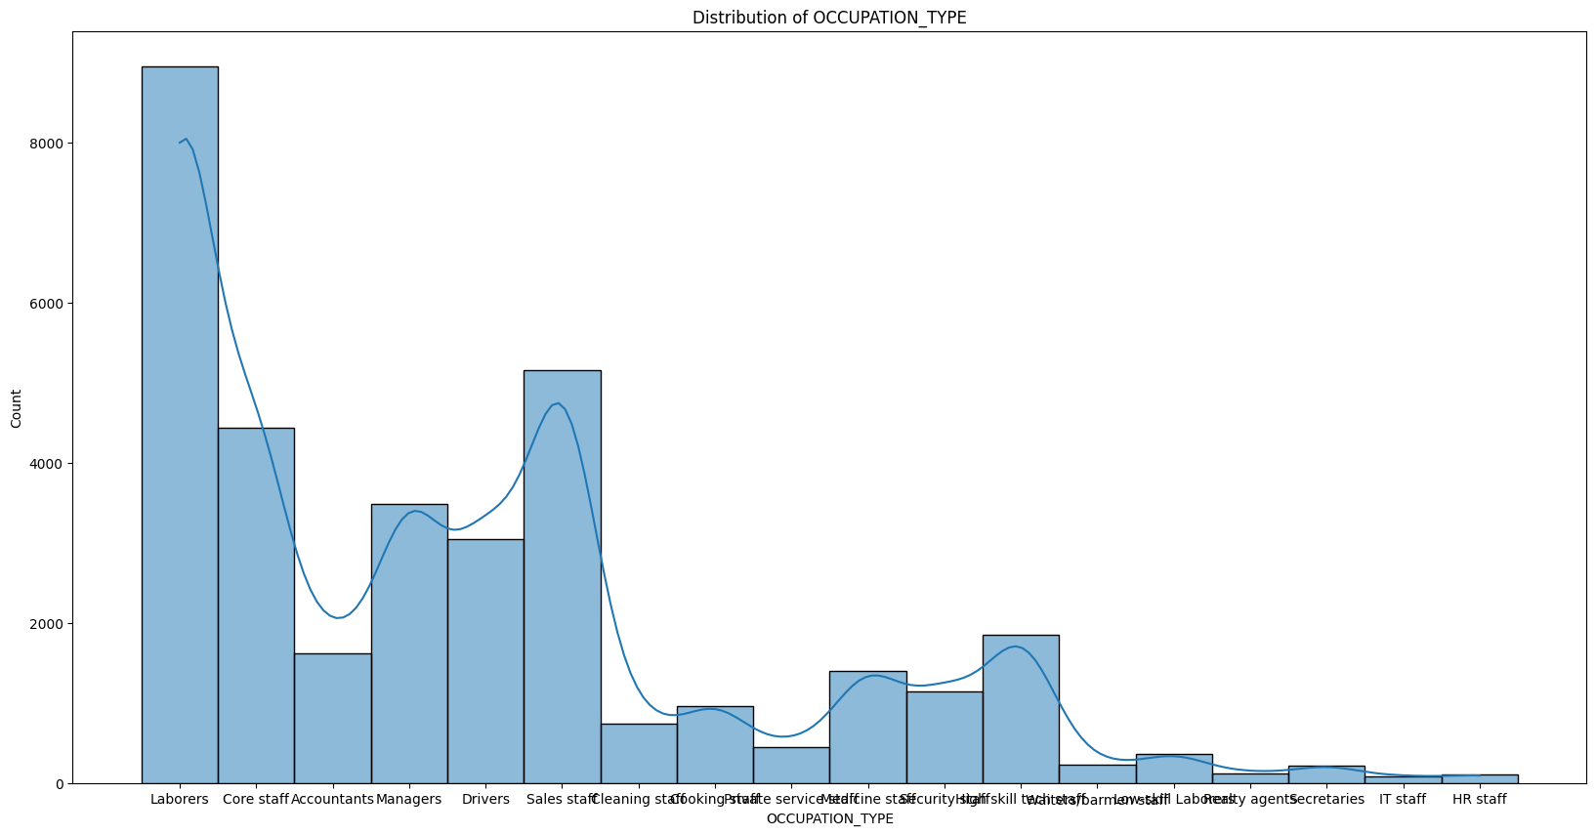
# Univariate analysis: Analyzing 'AMT_GOODS_PRICE'
plt.figure(figsize=(10,6))
sns.histplot(df['AMT_GOODS_PRICE'], kde=True)
plt.title('Distribution of AMT_GOODS_PRICE')
plt.show()
# Univariate analysis: Analyzing 'OCCUPATION_TYPE'
plt.figure(figsize=(20,10))
sns.histplot(df['OCCUPATION_TYPE'], kde=True)
plt.title('Distribution of OCCUPATION_TYPE')
plt.show()

Slide 78
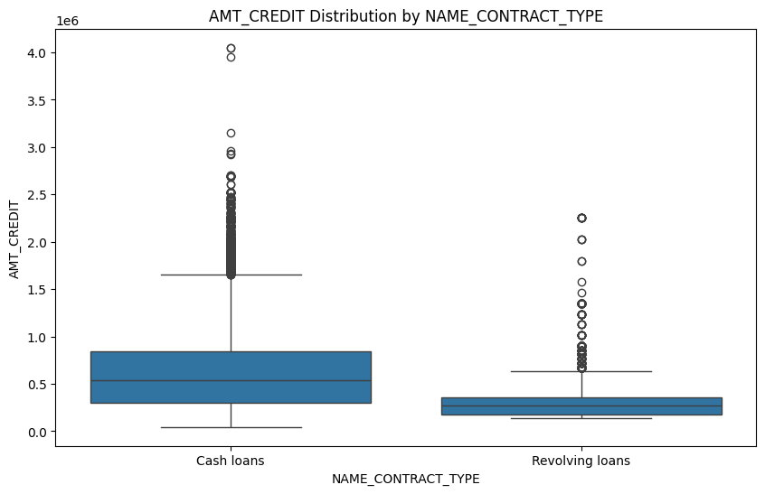
Segmented Univariate
# Segmented Univariate: Analyze 'AMT_CREDIT' across different 'NAME_CONTRACT_TYPE'
plt.figure(figsize=(10,6))
sns.boxplot(x='NAME_CONTRACT_TYPE', y='AMT_CREDIT', data=df)
plt.title('AMT_CREDIT Distribution by NAME_CONTRACT_TYPE')
plt.show()
# Analyze 'AMT_INCOME_TOTAL' across 'CODE_GENDER' segments
plt.figure(figsize=(10,6))
sns.boxplot(x='CODE_GENDER', y='AMT_INCOME_TOTAL', data=df)
plt.title('AMT_INCOME_TOTAL Distribution by Gender')
plt.show()

Slide 79
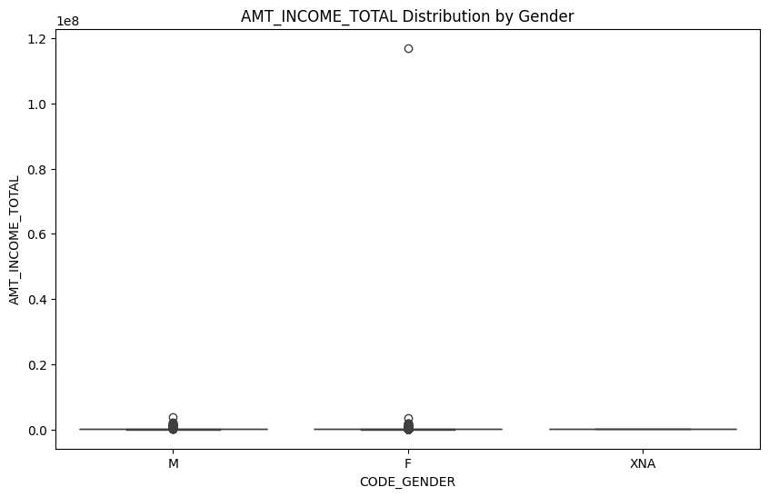
# Analyze 'AMT_INCOME_TOTAL' across 'CODE_GENDER' segments
plt.figure(figsize=(10,6))
sns.boxplot(x='CODE_GENDER', y='AMT_INCOME_TOTAL', data=df)
plt.title('AMT_INCOME_TOTAL Distribution by Gender')
plt.show()

Slide 80
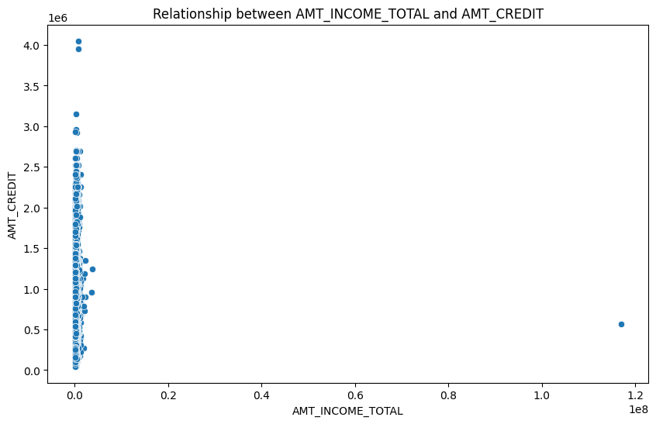
Bivariate Analysis
# Bivariate Analysis: Scatter plot between 'AMT_INCOME_TOTAL' and 'AMT_CREDIT'
plt.figure(figsize=(10,6))
sns.scatterplot(x='AMT_INCOME_TOTAL', y='AMT_CREDIT', data=df)
plt.title('Relationship between AMT_INCOME_TOTAL and AMT_CREDIT')
plt.show()

Slide 81
E. Identify Top Correlations for Different Scenarios: Understanding the correlation between variables and the target variable can provide insights into strong indicators of loan default.
Task: Segment the dataset based on different scenarios (e.g., clients with payment difficulties and all other cases) and identify the top correlations for each segmented data using Excel functions
We first identifies the numerical columns from the cleaned dataset and splits the data into two groups: those with payment difficulties (TARGET = 1) and all others (TARGET = 0). It calculates the correlation matrix for each group and extracts the top 20 correlations for both.
For the TARGET = 1 group, a correlation heatmap is generated using a subset of selected columns, highlighting the relationships between key variables such as credit amount, social circle observations, and days employed. The heatmap provides a visual representation of these correlations, using color gradients to indicate the strength and direction of each correlation.
For the TARGET = 0 group, a correlation heatmap is generated using the subset of specific columns related to social circle observations, credit amounts, regional ratings, family size, and loan details. The correlation matrix is computed for these variables, which measures how strongly they are related to each other. The chart highlights relationships between variables for customers with no payment difficulties.

Slide 82
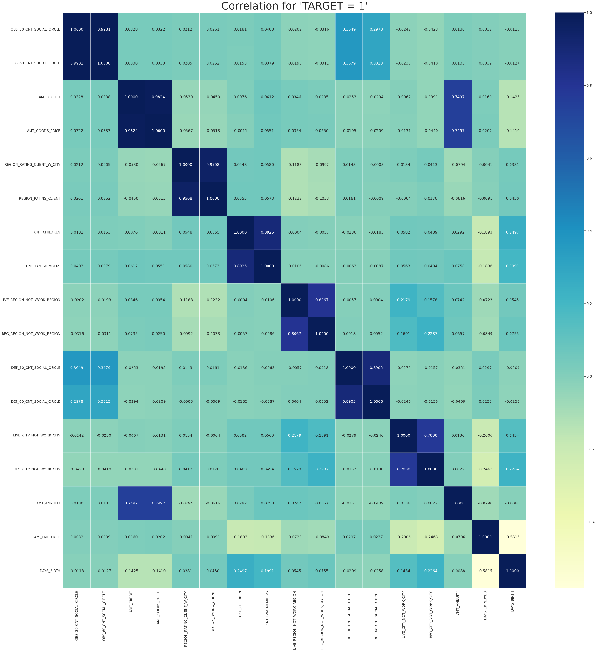

Slide 83
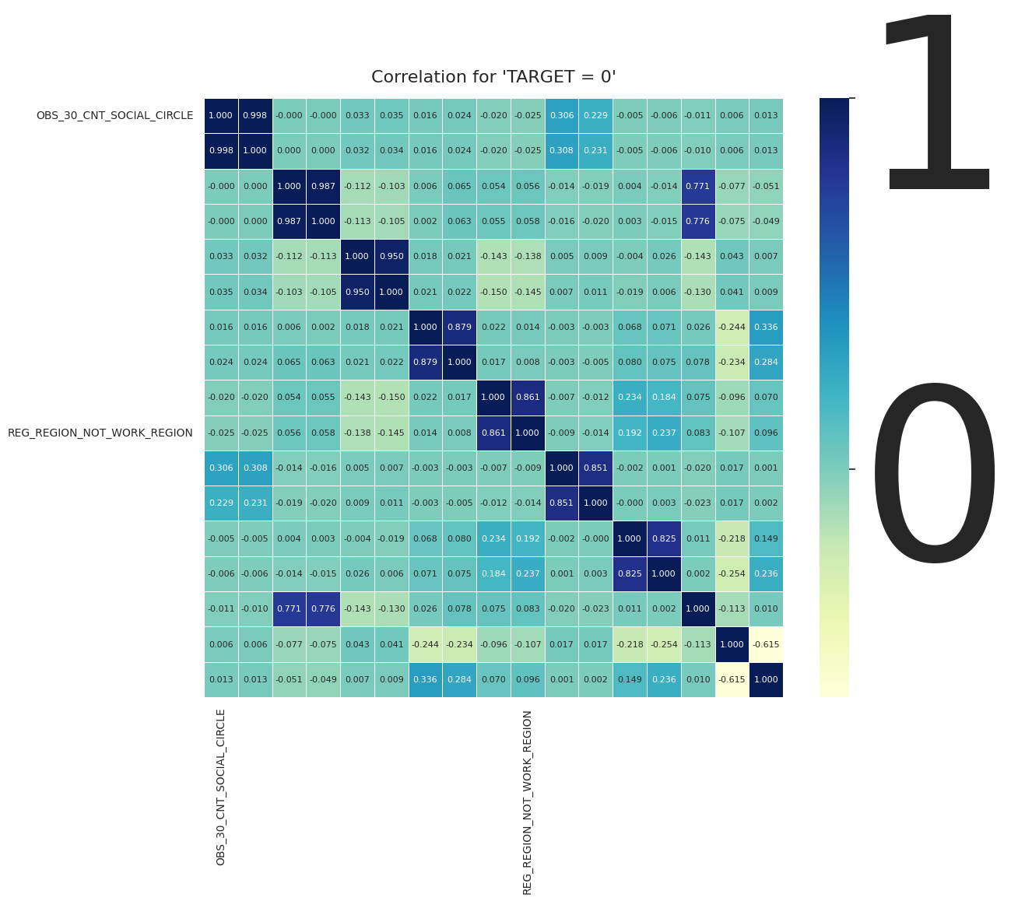

Slide 84
Conclusion:
The analysis revealed several key insights for the finance company:
Loan Amount and Default Risk: Higher loan amounts are strongly correlated with a higher likelihood of default, especially among customers with lower incomes. This suggests the company should consider lowering the loan amount for risky applicants or requiring additional collateral.
Customer Income and Education: Customers with higher income and education levels are less likely to default. These attributes should be prioritized during the approval process, offering potential for targeted marketing strategies.
Data Imbalance: The significant imbalance between defaulters and timely payers could lead to biased predictions. Implementing data resampling techniques like SMOTE (Synthetic Minority Over-sampling Technique) may help in predictive modeling.
Outliers: Some extreme values, especially in customer income, could distort predictions. Outliers should be closely monitored and handled according to business logic.
By focusing on these factors, the company can better assess the risks associated with each loan application and optimize its approval strategy to minimize financial loss.

Slide 85
Analyzing the Impact of Car Features on Price and Profitability
Final Project-3

Slide 86
The project focuses on analyzing the impact of various car features on their price and profitability. By using data analysis techniques, this study helps car manufacturers optimize their pricing strategies and product development decisions. The dataset contains 11,159 observations and 16 variables, including car specifications such as make, model, fuel type, engine power, transmission type, and MSRP (Manufacturer's Suggested Retail Price).
The goal is to understand how different features—like engine horsepower, fuel efficiency, and market category—affect car prices and consumer demand, allowing the manufacturer to balance profitability with market needs.
DESCRIPTION

Slide 87
APPROACH AND TECH STACK USED
The analysis employs techniques like:
Descriptive Statistics: Provides summary insights into car features, pricing, and trends.
Visualization: Charts like pivot tables, scatter plots, bar charts, and bubble charts visually capture trends.
Regression Analysis: Identifies which car features most strongly influence price.
Market Segmentation: Looks at how popularity and pricing vary across market categories and manufacturers.
The use of Excel for data manipulation, pivot tables, and Power BI for visualization enables an interactive dashboard, enhancing decision-making through dynamic insights.

Slide 88
Cleaning the Data
I have used power query editor in excel to clean the data.
In order to find the empty values i have used column quality option.
Further i have cleared the rows with empty values by using remove rows option
In the next step to have changed the data type of the column model to text and the column MSRP to currency.

Slide 89

Task 1.A: Create a pivot table that shows the number of car models in each market category and their corresponding popularity scores.
Crossover has the highest number of cars with 1103, followed by Flex Fuel and Luxury.

Slide 90

Task 1.B: Create a combo chart that visualizes the relationship between market category and popularity.

Slide 91

Task 2: Create a scatter chart that plots engine power on the x-axis and price on the y-axis. Add a trendline to the chart to visualize the relationship between these variables.
Higher the engine power higher the prize of the car.

Slide 92

Task 3: Use regression analysis to identify the variables that have the strongest relationship with a car's price. Then create a bar chart that shows the coefficient values for each variable to visualize their relative importance.
The engine cylinder is the most important factor in determining car’s price.

Slide 93

Task 4.A: Create a pivot table that shows the average price of cars for each manufacturer.
Task 4.B: Create a bar chart or a horizontal stacked bar chart that visualizes the relationship between manufacturer and average price.
Bugatti has the highest MSRP average which is about 1757223.667

Slide 94

Task 5.A: Create a scatter plot with the number of cylinders on the x-axis and highway MPG on the y-axis. Then create a trendline on the scatter plot to visually estimate the slope of the relationship and assess its significance.

Slide 95
Task 5.B: Calculate the correlation coefficient between the number of cylinders and highway MPG to quantify the strength and direction of the relationship.
The Correlation Coefficient between the number of cylinders and highway MPG is -0.61963.

Slide 96
Building the Dashboard
To build the dashboard I have used Microsoft Power BI
There are few new calculation done beforehand so that it would be easy to develop the dashboard.
Those values would be:
Average Horsepower
Average MPG
Average MSRP
Transmission Count

Slide 97

Task 1: How does the distribution of car prices vary by brand and body style?

Slide 98

Task 2: Which car brands have the highest and lowest average MSRPs, and how does this vary by body style?

Slide 99

Task 3: How do the different feature such as transmission type affect the MSRP, and how does this vary by body style?

Slide 100

Task 4: How does the fuel efficiency of cars vary across different body styles and model years?

Slide 101

Task 5: How does the car's horsepower, MPG, and price vary across different Brands?

Slide 102
Insights:
Popularity and Market Categories: Popularity varies significantly across different market categories, with luxury and performance vehicles attracting more attention.
Engine Power and Pricing: Cars with higher engine horsepower generally come with higher MSRPs, but this relationship is not strictly linear.
Key Features Affecting Price: Engine horsepower, market category, and brand are the most significant factors influencing a car’s price.
Manufacturer Pricing Strategies: Some manufacturers consistently produce high-priced cars, while others focus on affordability.
Fuel Efficiency: There is a trade-off between engine cylinders and fuel efficiency, impacting consumer choices based on driving preferences.

Slide 103
Conclusion:
This analysis provides actionable insights for car manufacturers to fine-tune their product lines and pricing strategies. By focusing on the most influential features—like engine power, market category, and fuel efficiency—manufacturers can create targeted products that align with consumer demand and maximize profitability. The use of regression analysis and interactive dashboards allows decision-makers to explore how changes in car features can impact market positioning and profitability.

Slide 104
ABC Call Volume Trend Analysis

Slide 105
PROJECT DESCRIPTION
This project focuses on Customer Experience (CX) analytics for an inbound calling team. The dataset covers a 23-day period and includes information such as agent ID and name, queue time, call time, call duration, and call status (abandoned, answered, or transferred). The objective is to analyze customer interactions to gain insights into customer experience and agent performance. The CX team plays a vital role in improving customer satisfaction by leveraging AI tools like IVR, RPA, and Predictive Analytics. The analysis aims to understand customer wait times, call outcomes, and the effectiveness of the inbound support process in fostering customer loyalty.

Slide 106
TECH-STACK USED
Microsoft Excel to analyze create pivot tables and charts, and to derive insights of the data.
Microsoft powerpoint to create the presentation of the process and insights of the project.

Slide 107




APPROACH
Analyzing the data provided
Extracting insights from the data
Creating charts to represent trends of the data
Presenting the results

Slide 108

Average Call Duration:
What is the average duration of calls for each time bucket?
In Order to get the average duration of calls in each time bucket i have utilized the pivot table. In this i have used time bucket in rows and average of call seconds in values and also have considered the call status in columns to get separated values for both calls answered and transferred.
Created a line graph to represent the duration of calls answered and transferred for each time bucket.
Created a bar chart for total call seconds for each time bucket

Slide 109


AVERAGE CALL SECONDS PER TIME BUCKET ON CALL STATUS
TOTAL CALL SECONDS PER BUCKET

Slide 110

Call Volume Analysis
Can you create a chart or graph that shows the number of calls received in each time bucket?
To obtain the number of calls received in each bucket I have pivot table with time bucket in rows and count of customer phone number and percentage in values.
Created a graph for count of customer phone number and the percentage as per call buckets where count is represented in bars and the percentage in line

Slide 111

Count of customer phone number and there percentage in each time bucket

Slide 112


Manpower Planning:
What is the minimum number of agents required in each time bucket to reduce the abandon rate to 10%?
Calculation for no. of agents needed to increase efficiency

Slide 113


Pivot table for agent required in each time bucket
Line chart comparing agents present vs agents required

Slide 114


Night Shift Manpower Planning
Propose a manpower plan for each time bucket throughout the day, keeping the maximum abandon rate at 10%.
Considering 30% calls are made during night with 10% abandonment rate the total number of agents required are 17. These agents are distributed accordingly into time buckets

Slide 115

Distribution of agents in time Buckets for night shift.

Slide 116
INSIGHTS
The highest average call duration is 22:54:17 at the time bucket 14_15.
The highest percentage of customer call duration is 12.40% at time bucket 11_12 with 14626 calls.
The total manpower need to reach 10% abandonment rate is 56 in the morning shift
Manpower needed at night considering 30% of the calls are made at night the total number of agents required would be 17.

Slide 117
APPENDIX
PROJECT
LINKS
Data Analytics Process Instagram User Analytics Operation Analytics and Investigating Metric Spike Hiring Process Analytics IMDB Movies Analysis Bank Loan Case Study Impact of Car Features ABC Call Volume Trend
Github
Linkedin
Link
Link
Link
Link
Link
Link
Link
Link
Link
Link

